Slide 1

IOT Project
Clicker to Monitor Programme

Slide 2
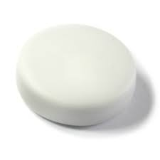

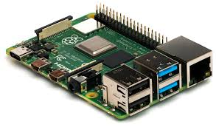
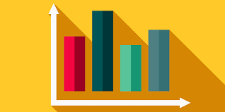


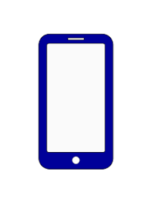



Flow Diagram
Mathlab Visualisations
Raspberry Pi writes captured information to ThingSpeak database.
Puck captures user input (Single-click positive, double-click negative)
Mathlab Visualisation used to determine effectiveness of programme by charts and alerts (email, SMS, dashboard)
Mobile app allows SNA to set monitor type.
Raspberry Pi captures and sends user interactions from puck back to mobile device.

